Slide 1
WBL IoT Presentation
By Anand Low Hong Ren

Slide 2
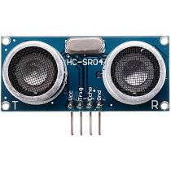
Assignment 1 Ultrasonic sensor with Raspberry Pi
Objective:
Measure distance using ultrasonic sensor HC-SR04

Slide 3
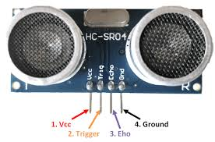
HC-SR04
Transmits and Receives 40 kHz ultrasound
Range of 2 to 400 cm
Voltage rating of 5V
Have 4 pins VCC, TRIG, ECHO, GND
Application
Proximity Detection
Obstacle Avoiding

Slide 4
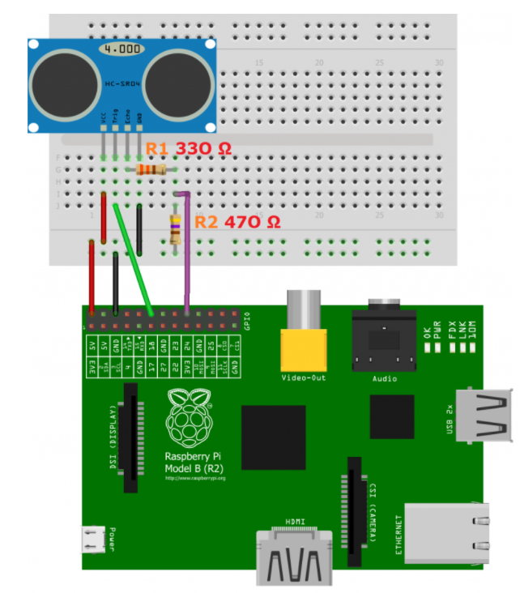
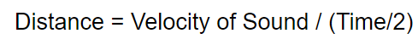
HC-SR04 Interface with Raspberry Pi
VCC connects to 5V power source
GND connects to ground
TRIG connects to GPIO as output
Requires 10µs to activate
ECHO connects to GPIO as input
Voltage divider with resistor 1㏀ and 2㏀ step down voltage to 3.3V
Formula to measure Distance:
Notes:
Speed of sound:343 metres per second

Slide 5
Program Flow
1㏀
Push button is pressed
Voltage signal sent to TRIG for 10µs10µs10µs
HC-SR04 transmit ultrasonic wave
Distance is measured.
HC-SR04 receive wave. ECHO receives input

Slide 6

Video Demo
Notes:
Video Demonstration

Slide 7


REST/HTTP using Raspberry Pi
Objective:
Setup Apache Web Server
Upload data in JSON format from the Python program via HTTP POST

Slide 8
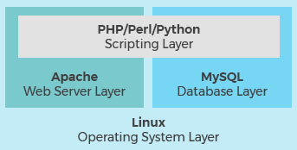
LAMP stack
Linux OS
Raspberry Pi OS is based on LInux
Apache Web Server
MySQL Database
open source relational database management system for storing application data
store all your information in a format that is easily queried with the SQL language
PHP
open source scripting language works with Apache to help you create dynamic web pages

Slide 9

Apache Web Server
free and open-source cross-platform web server software
processes requests and serves up web assets via HTTP
stable, mission-critical-capable serve
it runs more than 65 percent of all Web sites on the Internet

Slide 10
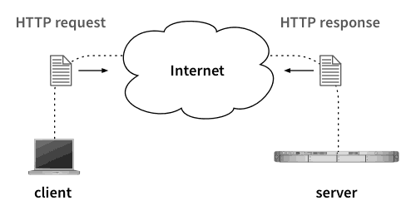
HTTP (HyperText Transfer Protocol)
application-layer protocol for transmitting hypermedia documents
designed for communication between web browsers and web servers
client-server model
stateless protocol
Notes:
HTML also application layer protocol
a client opening a connection to make a request, then waiting until it receives a response
the server does not keep any data (state) between two requests

Slide 11
Program flow
Push button pressed
Button count increase
Data placed inside dictionary, then convert into JSON format.
Index.php file receive data and responds
Data sent via HTTP POST

Slide 12
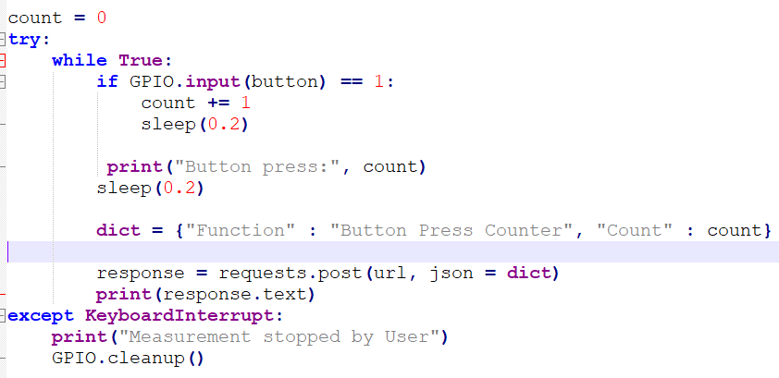
Code Snippets (Python Client)
Notes:
When the push button is pressed, the button pin becomes HIGH, and this increases the variable count by 1.
The dict variable creates a dictionary which lists the function of the program and the variable count.
Key and value
the program sends a HTTP POST request to the apache web server on the Raspberry Pi with the data in the dict variable as JSON format.
The response from the server is sent back to the program and is printed out.

Slide 13
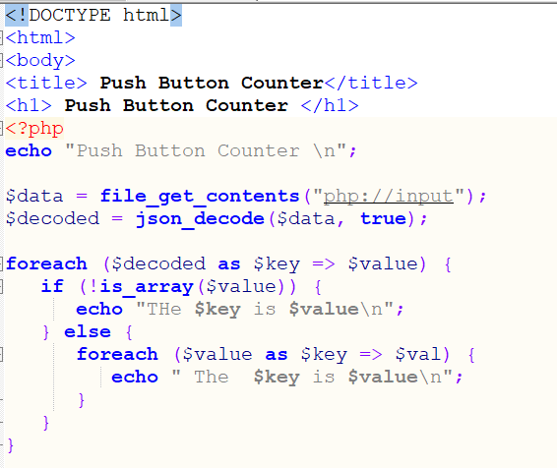
Code Snippet (Web Page File)
Notes:
file_get_contents to save the JSON data from the python program.
json_decode decodes the data from JSON format into an array format which can be displayed and used in the PHP program.
Each key and value pair in the array will be sent back as a response to the client, which is the python program.

Slide 14
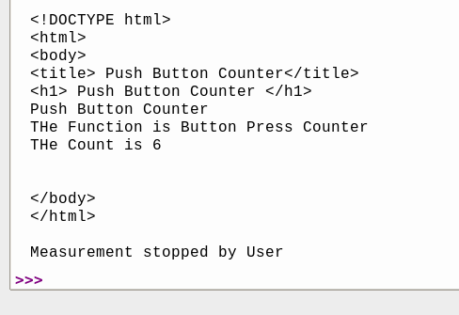
Result

Slide 15


Firebase integration using Raspberry Pi
Objective:
Upload data from Python Program onto the Firebase Realtime Database
Operate the python program remotely via Firebase

Slide 16
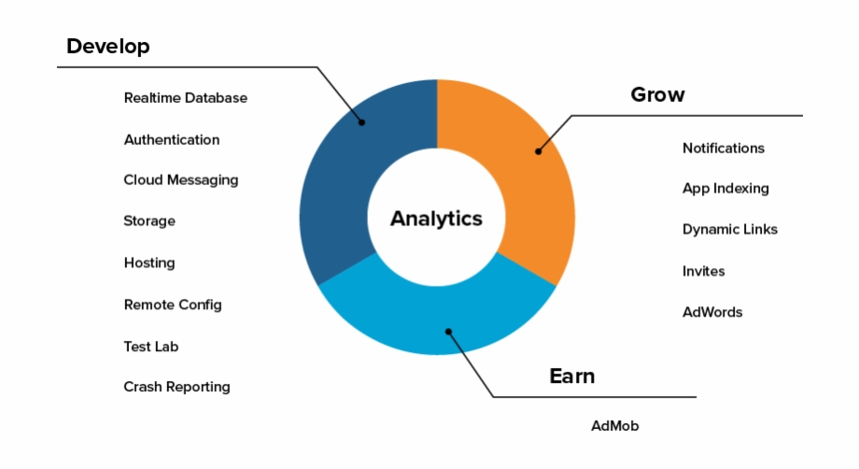
Firebase
Firebase is a toolset to build, improve, and grow your app
include :
Analytics
Authentication
Databases
File storage
Push messaging
Hosted in cloud
Managed by Google
Scalable

Slide 17
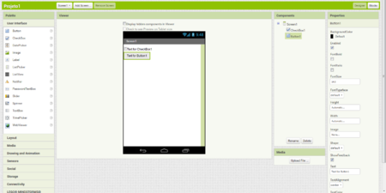
MIT App Inventor
web application integrated development environment
Can create apps for IOS and Android
Allows drag and drop visual objects to create an application
Notes:
Originally made by Google, but now maintained by MIT

Slide 18
Program Flow
User can turn on and off using the app
Data sent to Firebase realtime database and read by Python program
Python Program measures distance
Distance data sends to Firebase

Slide 19
Video demo

Slide 20

MQTT using Raspberry Pi
Objective:
Setup MQTT broker (server)
Send data from one client to the other via MQTT

Slide 21
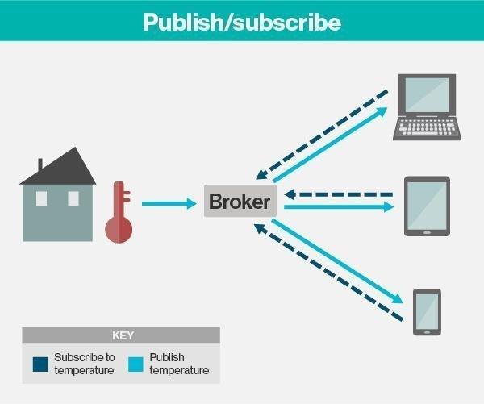
MQTT ( MQ Telemetry Transport)
lightweight messaging protocol
publish-subscribe way
Clients connect to a broker
Clients can publish data to the broker
Each data comes with a topic tag
Clients can subscribe to any topic to receive data
low network usage, due to small data packets
Notes:
A centralized broker or server is the centrepoint where clients send and receive messages to each other.
Clients can both publish or subscribe to message channels called topics, any data that passes on through the broker will be tagged with a topic label.
Suitable for different kinds of latency

Slide 22

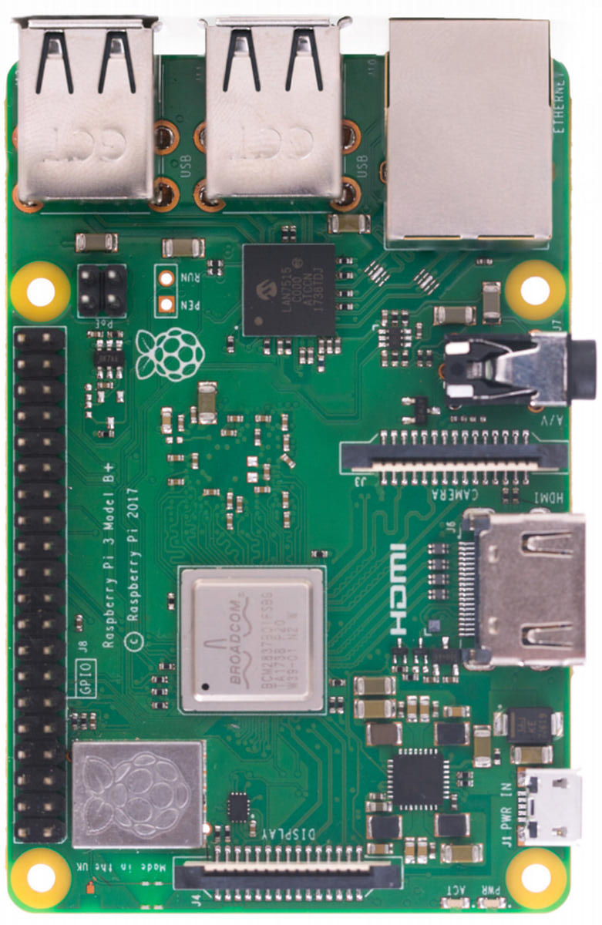
Program Flow
MQTT Broker (Pi)
MQTT Client (Pi)
MQTT Client (PC)
Subscribe
“distance”
“Distance” data sent
Publish “Distance” data

Slide 23
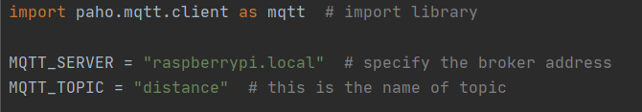
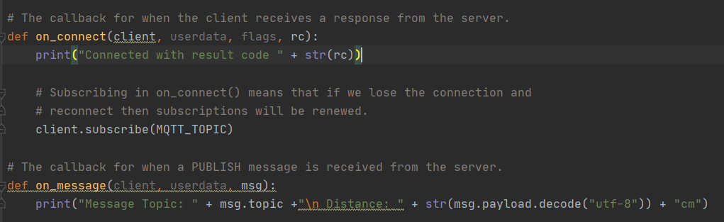
Code snippets ( MQTT client PC)

Slide 24
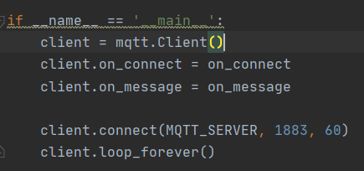
Code snippets (MQTT client PC)

Slide 25
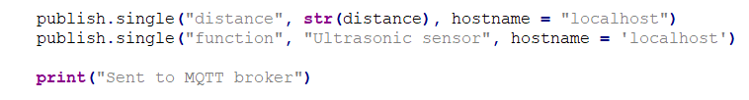
Code snippet ( MQTT client Raspberry Pi)

Slide 26
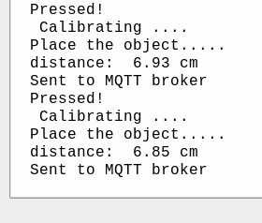
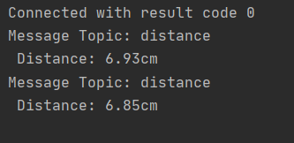
Results
On the PC
On the Raspberry Pi

Slide 27
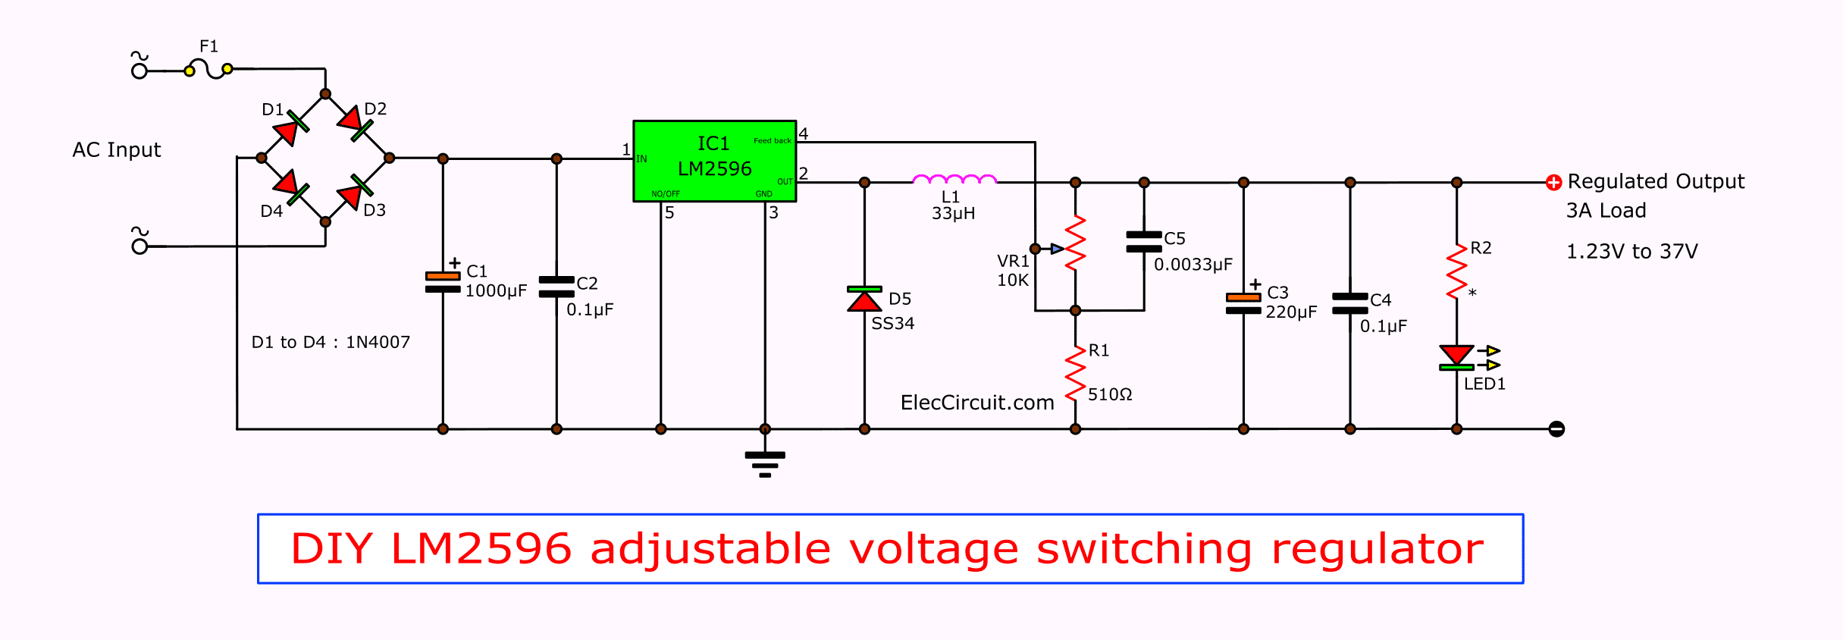
PCB Designing
Convert the circuit below into a PCB board design
Software used: Autodesk Eagle

Slide 28
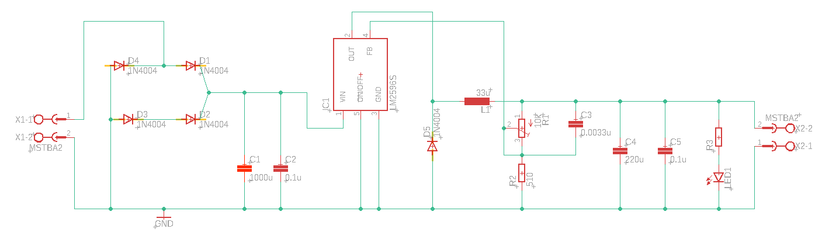
Schematic
Switching voltage regulator
DC output
AC Input
Notes:
switching element to transform the incoming power supply into a pulsed voltage, which is then smoothed using capacitors, inductors, and other elements

Slide 29
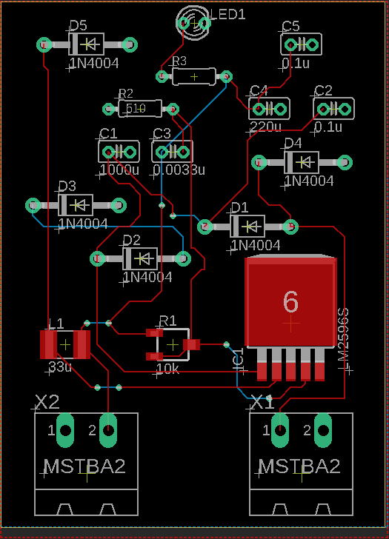
Place components on board and routing
1st attempt
Components were placed randomly without considering function
Routing messy and not ideal

Slide 30
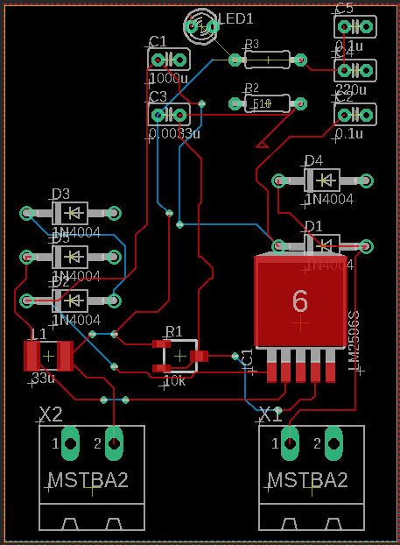
2nd attempt
Component is placed much neater
Components not placed based on their function
Trace for power require thicker trace
AC trace should group together
Routing can be improved further
Increased Impedance
May cause EMI emission
Notes:
Longer routing and vias increases impedance of circuit
Good practice to have 45 angle
popular theory is that high-frequency signals emit Radio Frequency radiation at every 90° turn of the copper track
Last time PCB manufacturing not so advance - 90 degree angle trace harder to manufacture and easier to break
Unless ultra high frequency >10GHz or microwave designs that need large 100 mils track

Slide 31
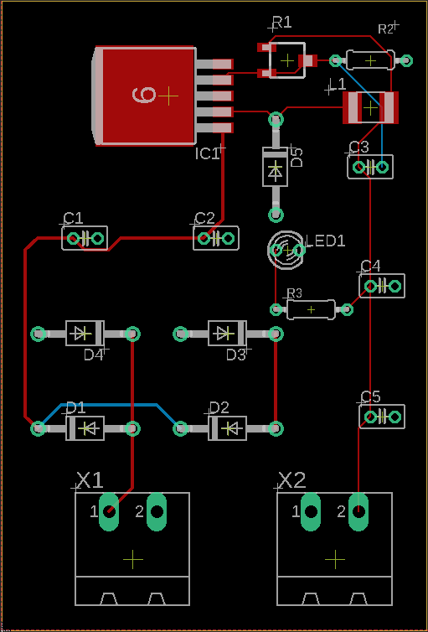
3rd attempt
Components group together and isolated properly
Routing is shorter
Components are placed very neat

Slide 32


Network Security
Types of Cyber Attacks
Access Attacks
Modification Attacks
Denial of Service Attacks

Slide 33
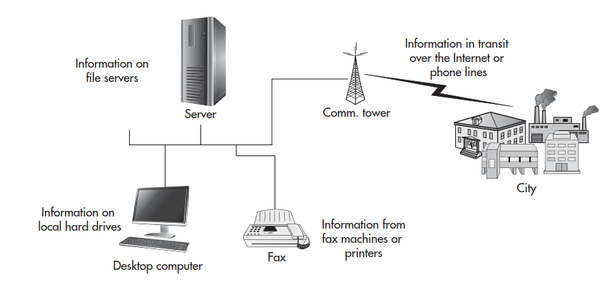
Access Attacks
an attempt to gain information or use a restricted resource or facility that the attacker is not authorized to see or use
Exploits vulnerable points in a network’s security software
view or steal data illegally
introduce viruses or other malicious software into the system

Slide 34

Modification Attacks
an attempt to modify information that an attacker is not authorized to modify
This type of attack is an attack against the integrity of the information.
Can be:
Changes
Insertion
Deletion
Notes:
-Changing employee salary
- Insert a transaction which costs the victim money
- Delete all the important files and documents

Slide 35
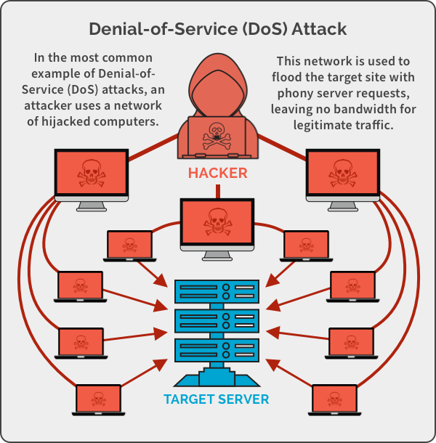
Denial of Service Attacks
deny the use of resources to legitimate users of the system, information, or capabilities.
Vandalism
Example:
Information: Encrypting other people’s information
Applications: Cannot perform tasks
Systems: Computer cannot function
Communication: Jamming communication or flood network

Slide 36
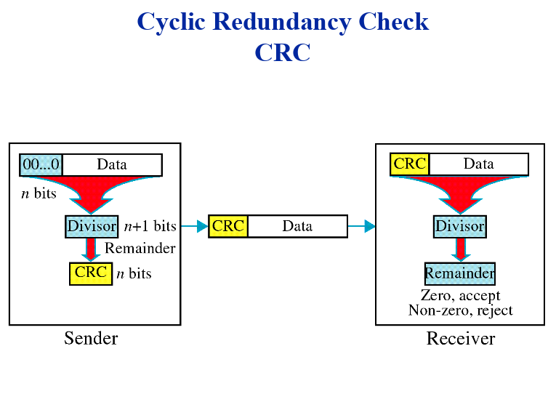
Cyclic Redundancy Check
Use:
Maintain data integrity
Check for changes/error in data
Data- binary
Both must have same divisor
Notes:
Binary data goes through algorithm becomes CRC
CRC and Data sent together
Receiver

Slide 37
Program flow
Divisor = 1001
Data = ON
Binary String Data
10011111001110
CRC code
10011111001110001
Notes:
Every character in a computer is represented by an integer. A is 65
O -79 N-78

Slide 38
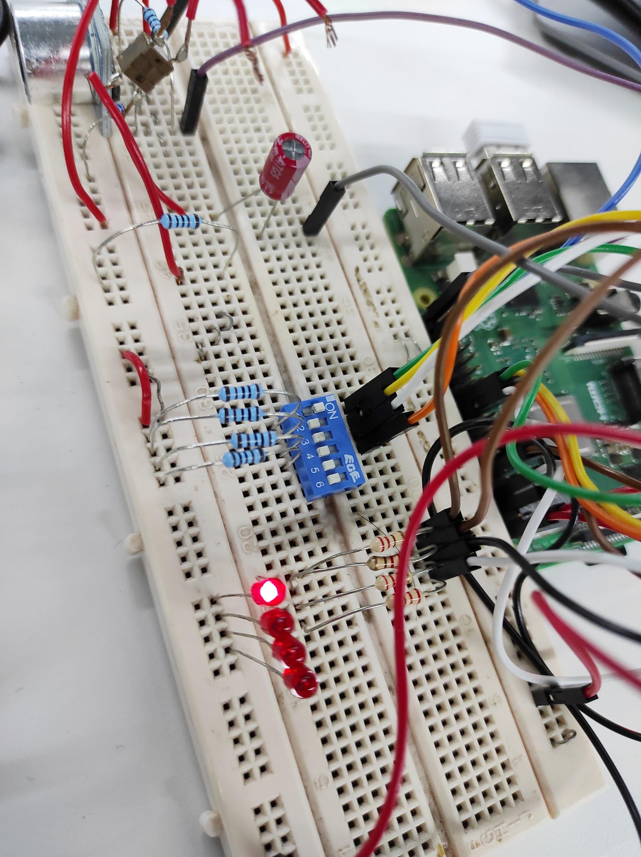
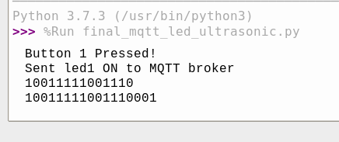
Sender

Slide 39
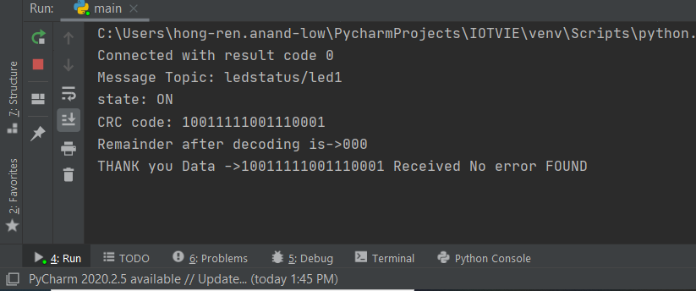
Receiver

Slide 40

Q & A session

Slide 41

The End

